Slide 1
Working with communities. EHS 215
SESSION 10

Slide 2
Introduction
Community is simultaneously a subsystem of society and is the society itself.
Consistent with adaptation and accommodation importance is placed upon the mutual causation: the citizen and the community influence each other with family, small group and organizations as intermediaries.

Slide 3
Definition of Community
Community is a population whose members;
  Consciously identify with each other
  May occupy common territory
  Engage in common activities
  Have some form of organization that provides for differentiation of functions, which allows the community to adapt to its environment, thereby meeting the needs of its components.
Components include the persons, groups, families and organizations within its population and the institutions it forms to meet its needs.

Slide 4
Functions of community
The functions the community performs include the maintenance of a way of life or culture.
Another important function is the satisfaction of common needs, interests, and ambitions.
Members of a community must be aware of its “we-ness”.

Slide 5
The importance of the social environment, including the community, is providing a medium for the evolution of the person.
Other components such as families, organizations, and groups must also be able to identify with and find common cause with the community’s way of life in order that their energies may be used to meet the community’s needs.

Slide 6
Cont’
The term “common cause” was adopted as the name of a national citizen’s action organization that explicitly recognizes the necessity to involve citizens and to draw upon their energies.
For environment/suprasystem – a community must also meet the needs of its environment in order to survive.

Slide 7
Aspects/features of Community Systems
Evolutionary Aspects – the first cities were burial places to which wandering tribes returned at certain times to perform ceremonies that ensured the stability of the universe.
The character of a particular community is determined by its relationship to other communities and the society within which it exists, by the characteristics of its components.

Slide 8
Cont’
How a sense of community will be maintained is not clear.
Divisions of social class or status, ethnic or racial heritage, religion, or ideology, continue to frustrate efforts to strengthen a sense of “the common” shared by all inhabitants.
The shape taken by cities of the future is being determined by experiences and crises in cities today.

Slide 9
Cont’
Structural Aspects (Boundaries) – the boundaries that separate communities from larger and smaller social units (the so-called vertical hierarchy) are often difficult to establish precisely.
Communities are subordinate to larger, regional networks and to industrial and communication centers in their economic and social affairs.

Slide 10
Cont’
Boundaries within the community include those between institutions that differentiate tasks.
Institutions – differentiation of function by assigning them to specialized subsystems lead to the emergence of institutions within communities.
The form the institution takes in a particular community depends upon the community’s components, it previous steady states, and its environment.

Slide 11

Who are Stakeholders?
Who do you consider to
be stakeholders I when working with communities

Slide 12
Examples of Stakeholders
MOH (National, Provincial/Regional, District)
Donors, CAs, Associations
NGO/CBO partners
Health Facility ( service providers, support staff, outreach workers)
Community (chiefs, religious leaders, women leaders, community group leaders, community resource persons and traditional health workers)

Slide 13
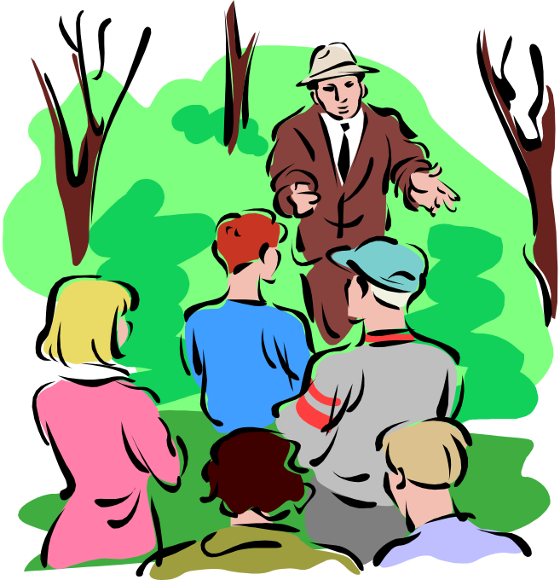
Community Stakeholder Participation
Why is it important to
involve community
members in programs?

Slide 14
Benefits of Community Participation
Increased ownership, support and responsibility
More likelihood of, and sustainability for, behavior change
More cost-effective programming
Better response to community needs and concerns
Notes:
Community Participation not only increases ownership, but it also instills a sense of greater responsibility for the program & for FP in general.
Due to community support , enabling environment & role models Behavior change is more likely & more likely to be sustained.
Programming is more cost-effective b/c project resources are often supplemented by community resources (such as labor or in-kind resources).
B/c community members participate in problem identification, prioritization & decision-making, the program can respond better to their needs & concerns.

Slide 15
Benefits of Community Participation continued:
More culturally appropriate strategies and messages
Increased coverage and access to information and services
Increased demand
Increased advocacy for service and policy change
Increased success (results and sustainability)
Notes:
B/c of the community’s input, FP program strategies & messages are often more culturally appropriate & acceptable.

Slide 16
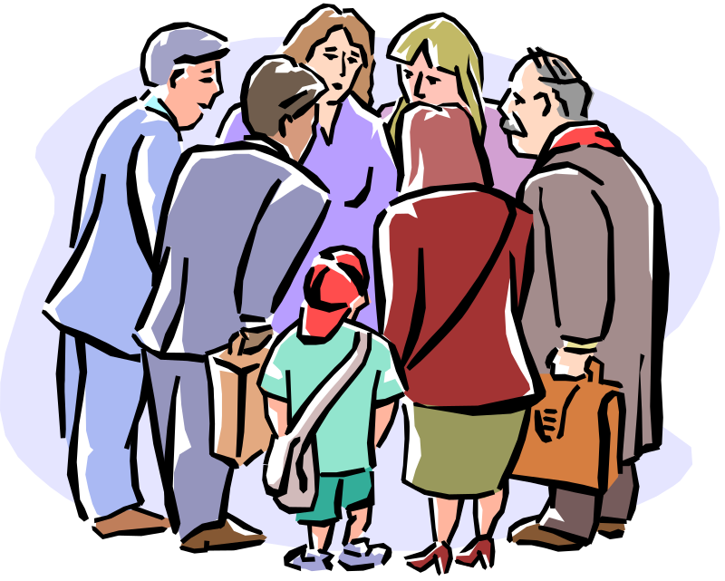
Community Mobilization
What is community
mobilization?

Slide 17
Community Mobilization
A capacity-building process through which individuals, groups,
or organizations plan, carry out, and evaluate activities on a
participatory and sustained basis to improve their health and
other needs, either on their own initiative or stimulated by
others.
From How to Mobilize Communities for Social Change by Howard-Grabman and Snetro 2004:3

Slide 18
Cont’
Community mobilization is based on the simple premise that human beings are by nature social creatures whose behaviors, attitudes and beliefs are profoundly affected by the norms of the communities in which they live. It is the process of engaging communities to change the norms within their own communities. By its very nature it tends to be a primary level intervention. Its goal is to engage the community itself in activities that can prevent incidents of sexual and domestic violence.

Slide 19
Why Community Mobilization?
Development is done best when it emerges from within local communities
Working with Community groups means strengthening or facilitating the establishment of a vibrant citizenry and Civil Society
A process that equips community groups and local governments the tools to demand their entitlements
It helps community groups play their role as interlocutors
Notes:
Civil society can be broadly defined as, “the realm between the household/ family and the state, populated by voluntary groups and associations, formed on the basis of shared interests, and are separate and/or largely but not necessarily completely autonomous from the state”

Slide 20
Enhances the capacity for collective civil action and repair civic failures by bringing the interests of citizens to the attention of the state by:
Enabling the community to coordinate and manage its own affairs on its own
Encouraging the community to represent its collective interests to the agents of the state and persuade the state to be more responsive to its needs

Slide 21
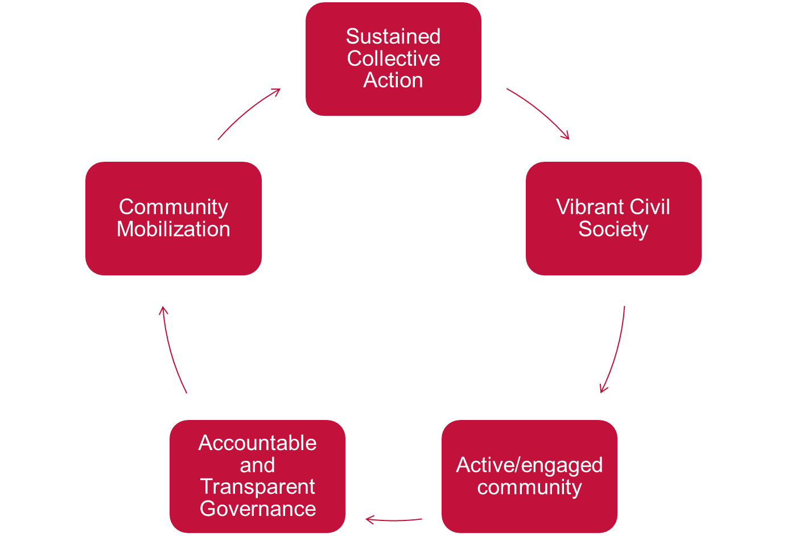

Slide 22
Community involvement also helps to reduce transaction costs as communities take ownership of the projects and play their part by bringing whatever materials, labor and skills they have to the fore
Facilitates access to information, transparency, and consultation in decision-making process= empowerment of disenfranchised communities
It builds trust among the community and motivates them to get involved even more

Slide 23
It can also encourage dialogue between groups otherwise separated by wealth, gender, or social status, thereby creating the basis for greater social cohesion
When done successfully, it helps communities shape public policy, keep governments accountable, and foster the well-being of their members and citizens at large

Slide 24
Elements of the Community Mobilization
Assessment – Getting to know potential communities, partners and the context
Community Action Group Formation – Assessment findings help determine with which sections of communities programs will work for (representation)
Action Planning – brainstorming options and drafting the implementation processes of potential community projects

Slide 25
Project Selection and Verification – At this phase the options prepared through the action planning process are presented for selection by the larger community and documentation captures how consensus was reached.
Project Formulation and Contract Signing- documentation made available to the whole community
Project Implementation – Communities mobilize their own resources and lead implementation, monitoring and evaluation. Over time, our material and organizational inputs decrease to the point of full handover

Slide 26
Handover – we work with Communities and other relevant actors to implement the exit strategy, provide final support to ensure Maintenance of project results and plan for post-program evaluation for learning and growth.

Slide 27
Key Tasks Involved in Mobilizing Communities
Developing an ongoing dialogue with community members regarding pressing needs
Creating or strengthening community organizations aimed at improving the well being of the community
Assisting in creating an environment in which individuals can empower themselves to address their own and their community’s needs

Slide 28
Promoting community members’ participation in ways that recognize diversity and equity, particularly of those who are most affected
Working in partnership with community members in all phases of a project to create locally appropriate responses
Identifying and supporting the creative potential of communities to develop a variety of strategies and approaches to improve their status

Slide 29
Skills of Community Mobilization
Communication: crucial in enabling people to work together on a common task or towards a common goal.
Listening: Active listening requires a demonstration of interest in hearing what is said, in clarifying points and in being able to summarize information accurately.
Notes:
Communities can participate meaningfully only if they have access to the same accurate information

Slide 30
Negotiation: important in facilitating complex processes with many different stakeholders with various levels of power and decision-making capacities.
Good observation: skills and curiosity enable people to discover many things that are happening in a community that might not be spoken about

Slide 31
Don’ts
Dos
Do it all for the community
See professionals as the experts
Deny ethnic and cultural differences of a community
Plan mobilization efforts alone
Focus solely on individual efforts
Do it with the community help
Use community expertise
Understand ethnic and cultural differences of communities and build
on ethnic and cultural diversities
Include others in the planning process
Develop community partnerships

Slide 32
Challenges of Community Mobilization
May create tension for the organization, including deciding how much authority will be given to activist groups associated with the organization to decide the agenda ·
May create backlash/tension as a result of a more direct action agenda
Requires leadership skills that may not readily exist within the organization

Slide 33
Cont’
Requires expanded personal commitment from people doing the work, i.e. walking the talk ·
Can open the door to new constituencies/communities; is the organization committed to doing whatever it takes (e.g. dealing with institutional racism)?
Requires an intense commitment of resources and leadership; community mobilization may be perceived as less important than direct services, requiring consensus or buy-in on priorities

Slide 34
Cont’
May bring up internal tension because a community mobilization agenda can challenge the status-quo mindset of the organization ·
Challenges the organization to decide what kind of partnership it wants in working with men at the community level ; may require new training program for women and men working as allies.
Challenges the organization to develop new ways of working with youth as agents of change instead of recipients of services

Slide 35
Benefits
Expands the base of community support for the organization ·
Brings new volunteers who otherwise might not get involved in your organization ·
Deepens the analysis of transformation and provides an opportunity for the organization and individuals to evolve

Slide 36
Creates public presence/pressure to change laws, policies and practices that a single individual could not accomplish or may be at risk to accomplish · Infuses new energy into the organization ·
Promotes community ownership for a problem and expands the base of support for the work
Helps promote sustainability for work (beyond funding cycles for projects) and long-term commitment to a social change movement

Slide 37
Cont’
Offers women’s organizations an opportunity to work in partnership with progressive men in the community·
Creates strategies that are effective in reaching underserved populations and communities of color by directly involving people from those communities ·
Helps organizations develop new leadership skills in the area of community development
Helps all of us celebrate positive change in our communities

Slide 38
Steps to Take - How to get started
1. Establish a relationship with a community
2. Identify and recruit stakeholders
3. Gather stakeholders together into a Mobilization Team
4. Engage your Mobilization Team in developing a plan: a). an asset mapping and/or community assessment process b). developing an analysis of sexual and/or domestic violenc c). developing a community mobilization plan d). developing an evaluation plan

Slide 39
Cont’
5. Engage your Mobilization Team in implementing the plan:
a). implementing a community mobilization plan
b). cultivating/maintaining assets
c). evaluating progress
d). assuming leadership roles in the mobilization process e. developing a sustainability plan

Slide 40
Preparing for a Community Based Program
Collect geographic and demographic data
Collect baseline FP data; review research and survey information
Contact existing organizations and institutions (NGOs, CBOs, local MOH)
Involve national and senior officials

Slide 41
Channels for Reaching the Community
NGOs
CBOs
Local government
Local leaders – traditional and formal
Community Resource persons
Special clubs or interest groups

Slide 42
Community Entry, and Gaining Effective Participation
Contact meetings with community leadership to establish interest, support and buy-in
Stakeholder sensitization workshops to determine:
community participation
involvement of men, women and other target groups,
geographic and demographic coverage
goals & objectives
clear roles and responsibilities and level of commitment (i.e community participation plan)

Slide 43
Community Action Planning:
Actions should:
1) address problems agreed upon by community partners
2) include strategies that:
-Address quality
-Increase access & informed choice
-Increase demand
-Increase FP coverage
-Outline persons responsible, resources needed & where to obtain them
-Provide a timeline & M&E plan
-Address partners’ skills & capacity building needs

